Slide 1
SALES PERFORMANCE ANALYSIS
PRESENTED BY
M .PRASANNA BALAJII
1

Slide 2
Objective
Data Preparation
Data Analysis
Dashboard
Key Insights
Agenda
2

Slide 3

Objective:
To evaluate overall sales and profit performance across regions and product categories.
To analyze key business metrics such as total sales, total profit, quantity sold, and average order value.
To identify the highest-performing regions and product categories using Excel-based analysis and visualization.

Slide 4
Data Preparation
Checked the dataset for missing and incorrect values.
Standardized region and product category names.
Corrected inconsistent data entries.
Filled the missing Profit value using the average.
Prepared the cleaned dataset for analysis.
Tools Used:
Excel Formulas, Sorting and filtering, Pivot tables, Slicers, Pivot Charts

Slide 5
Data Analysis Tasks.
Calculated total sales, total profit, quantity sold, and average order value.
Analyzed sales and profit performance across regions and product categories.
Created Pivot Tables and Pivot Charts to summarize the data.
Compared regional and category performance using interactive filters and slicers.
Use conditional formatting to highlight orders
Excel Features Used:
SUM, AVERAGE, COUNT, Pivot Tables, Pivot Charts, Slicers
5

Slide 6
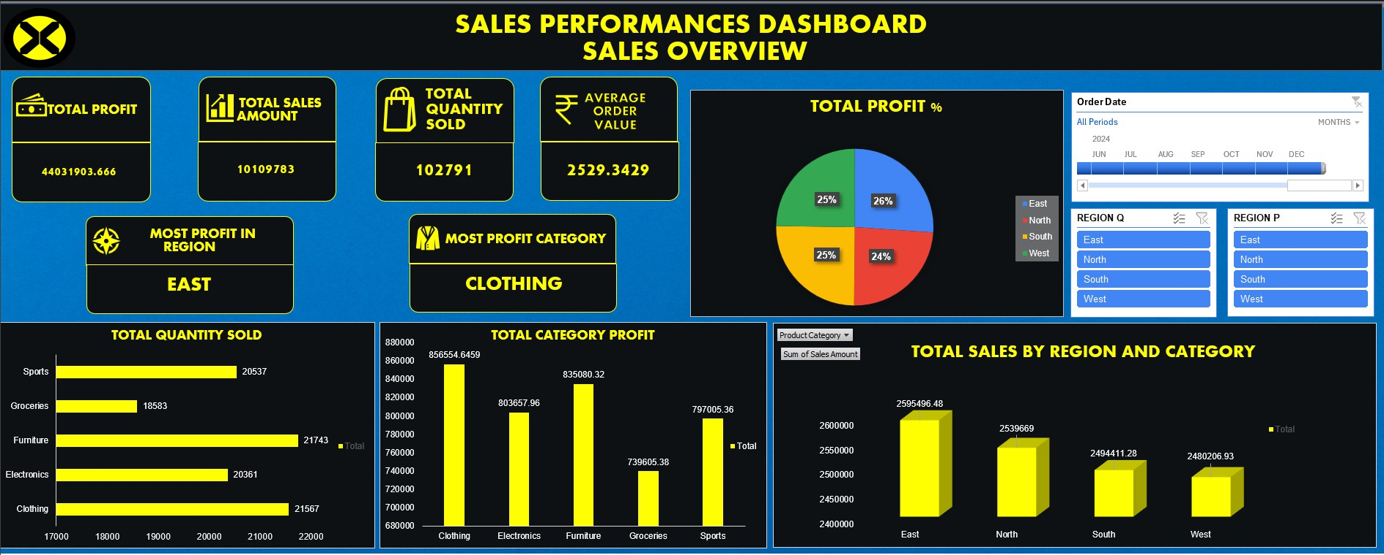

Slide 7

Key Findings
East recorded the highest total Profit among the four regions.
Total 10271 quantities sold in all regions and for all categories
Clothing was the most profitable product category.
Regional sales performance was relatively balanced, with each region contributing a similar share.
The dashboard shows total sales of approximately 10.11M and an average order value of approximately 2,529.
Pivot Tables, Pivot Charts, KPI cards, and slicers provide an interactive view of sales performance.
7

Slide 8
Thankyou
.
8

